Slide 1

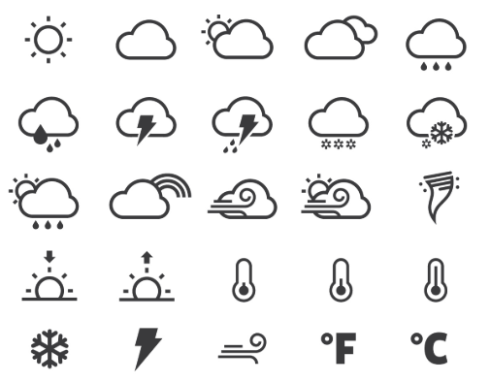
Is Mother Nature a Football Fan?
Team E
27 June, 2018

Slide 2
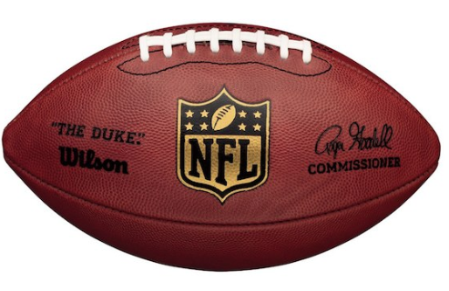
Game Plan
Data Sources and Data Massaging
First Quarter: Does Weather impact Attendance or Home Team Performance?
Second Quarter: Does Weather impact Play Selection?
Third Quarter: Does Weather affect Score?
Fourth Quarter: Was Tom Brady Guilty of Deflating Footballs?
Overtime: Bonus Analysis

Slide 3
Data Sources and Data Massaging

Slide 4




We Had to Massage our Data Like Tom Brady’s Ego After a Super Bowl Loss to the Eagles
NFL makes it harder to acquire their data versus other professional leagues
Used variety of different data sources
GitHub repositories - game outcome and play by play
Pro Football Reference - game attendance data
Wikipedia - stadium coordinates and capacity
Dark Sky API - combine game outcome data with weather attributes
Saved everything back to normalized csv files for easy use in project
Removed games played in domes from analysis
Created bins (buckets) for different weather attributes like temp, wind
Notes:
Roger Goodell is basically a dictator
Baseball sabermetrics basically started sports analytics - moneyball

Slide 5
First Quarter
Does Weather Impact Attendance or Home Team Performance?

Slide 6
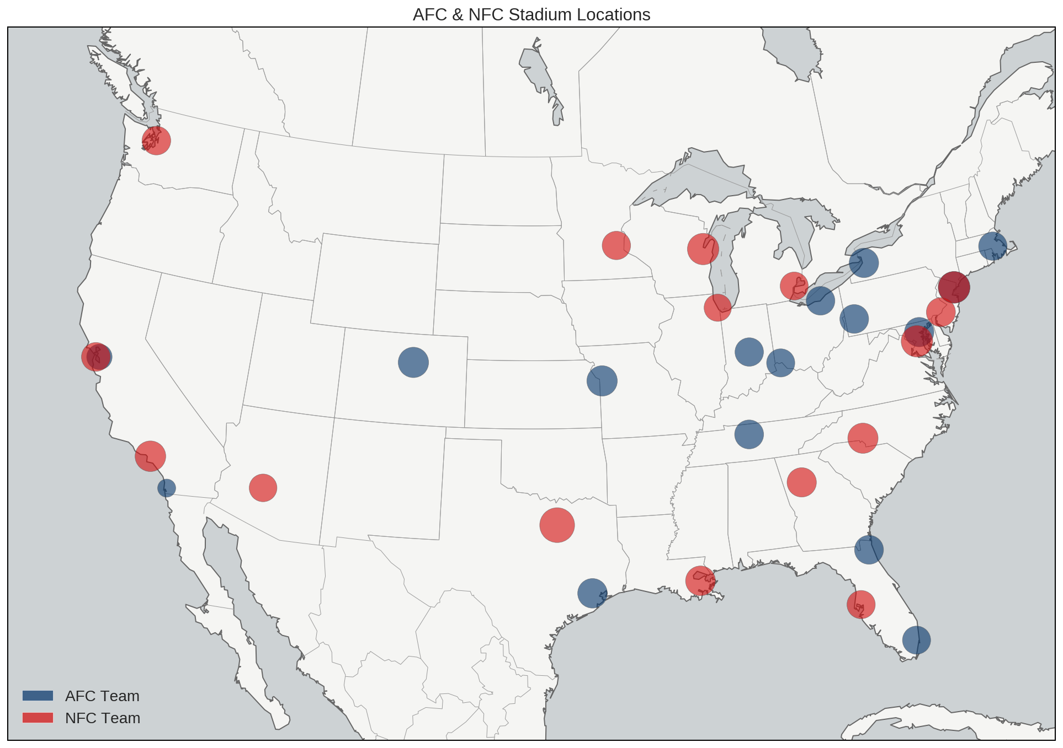

NFL Stadium Locations
Notes:
Location will clearly affect the weather a team is used to playing in.
San Diego Chargers Stadium is smaller, currently at a temporary stadium until LA stadium is complete.
One dot that is darker red – MetLife for Jets and Giants.
Looks like there is a goat loose in New England, not sure how that happened

Slide 7
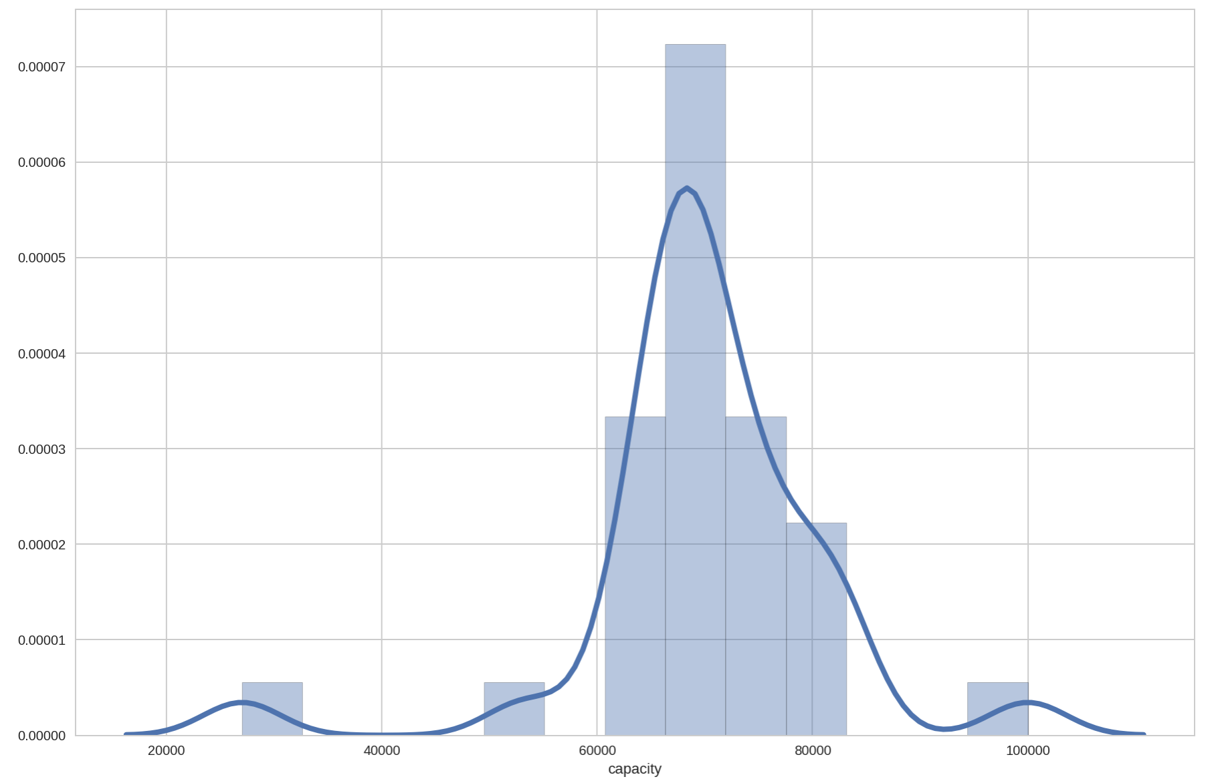
NFL Stadium Capacity Density Plot with Histogram
Notes:
It’s hard to tell from bubbles in previous chart, but from this density plot and histogram we can see the average NFL stadium capacity is around 70,000, with a few notable outliers, the previously mentioned San Diego Chargers on the low end, and Dallas Cowboys on the high end.

Slide 8
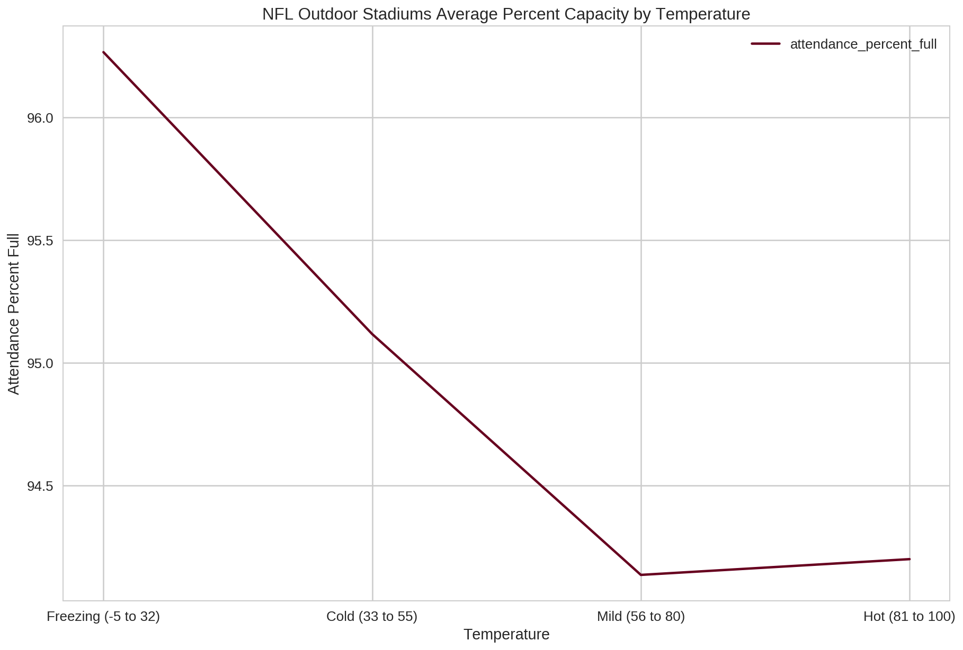
NFL Fans are Tough As Nails
On average, stadiums are filled closer to capacity when the temperature is colder
Fans attend games more often later in the season when the temperature is colder, but the stakes are higher
Notes:
This could be explained by the fact that the NFL season starts in late summer and finishes in early winter.

Slide 9
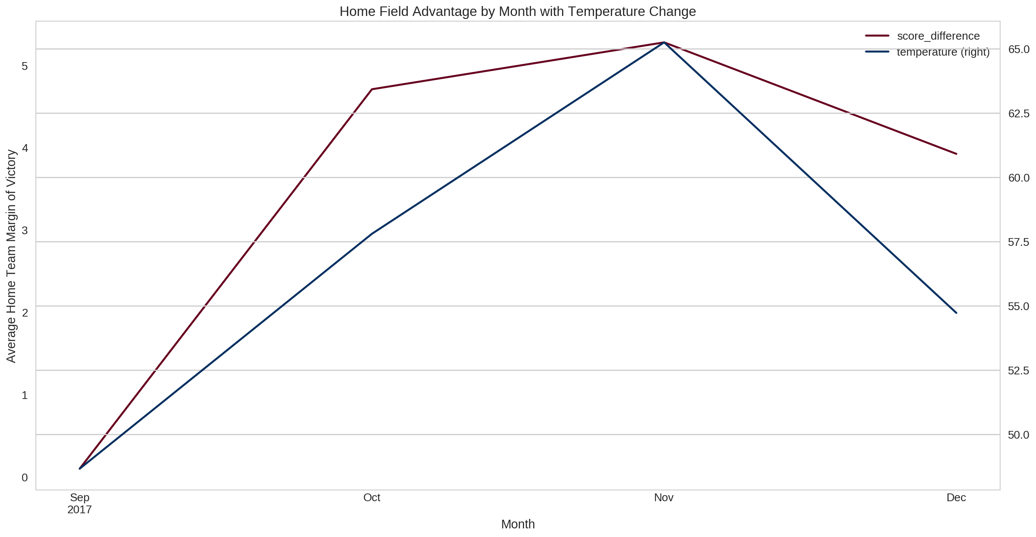
It’s Getting Hot In Here: Home Teams Thrive in the Heat
Home Teams performed the best when the average game temperature reached its highest point at the beginning of November

Slide 10
Second Quarter
Does Weather Impact Play Selection?

Slide 11
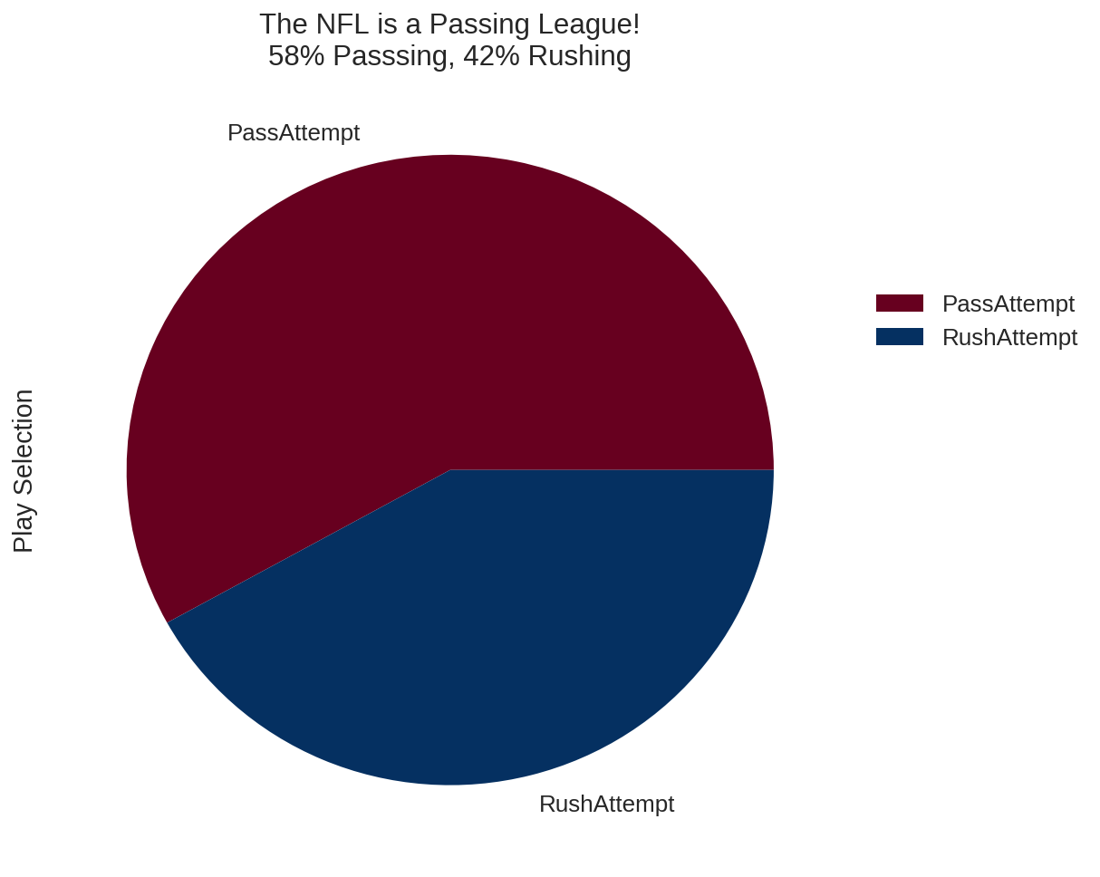
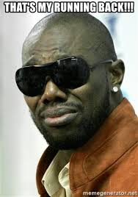
Fantasy Football Killed the Running Back Star
In 2017:
58% passing plays
42% rushing plays

Slide 12
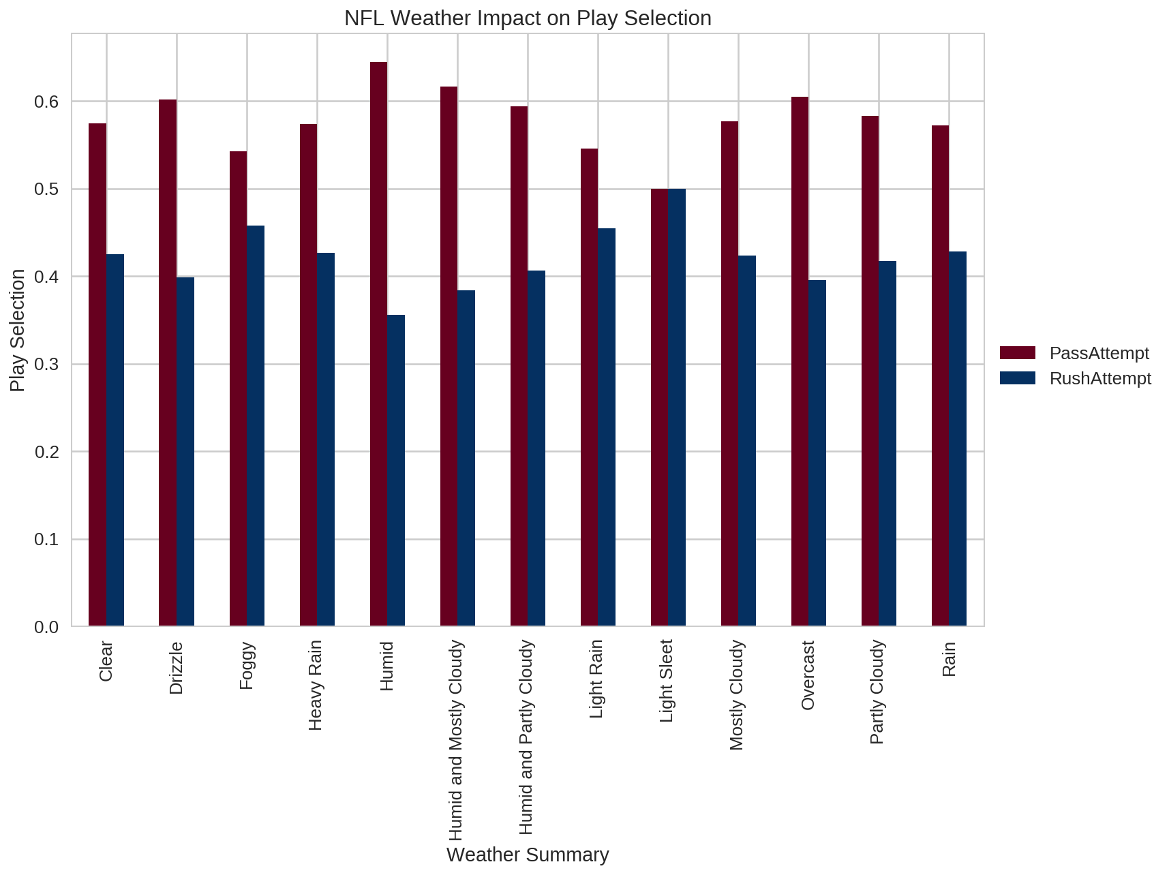
Flip a Coin: Heads or...Sleet?

Slide 13
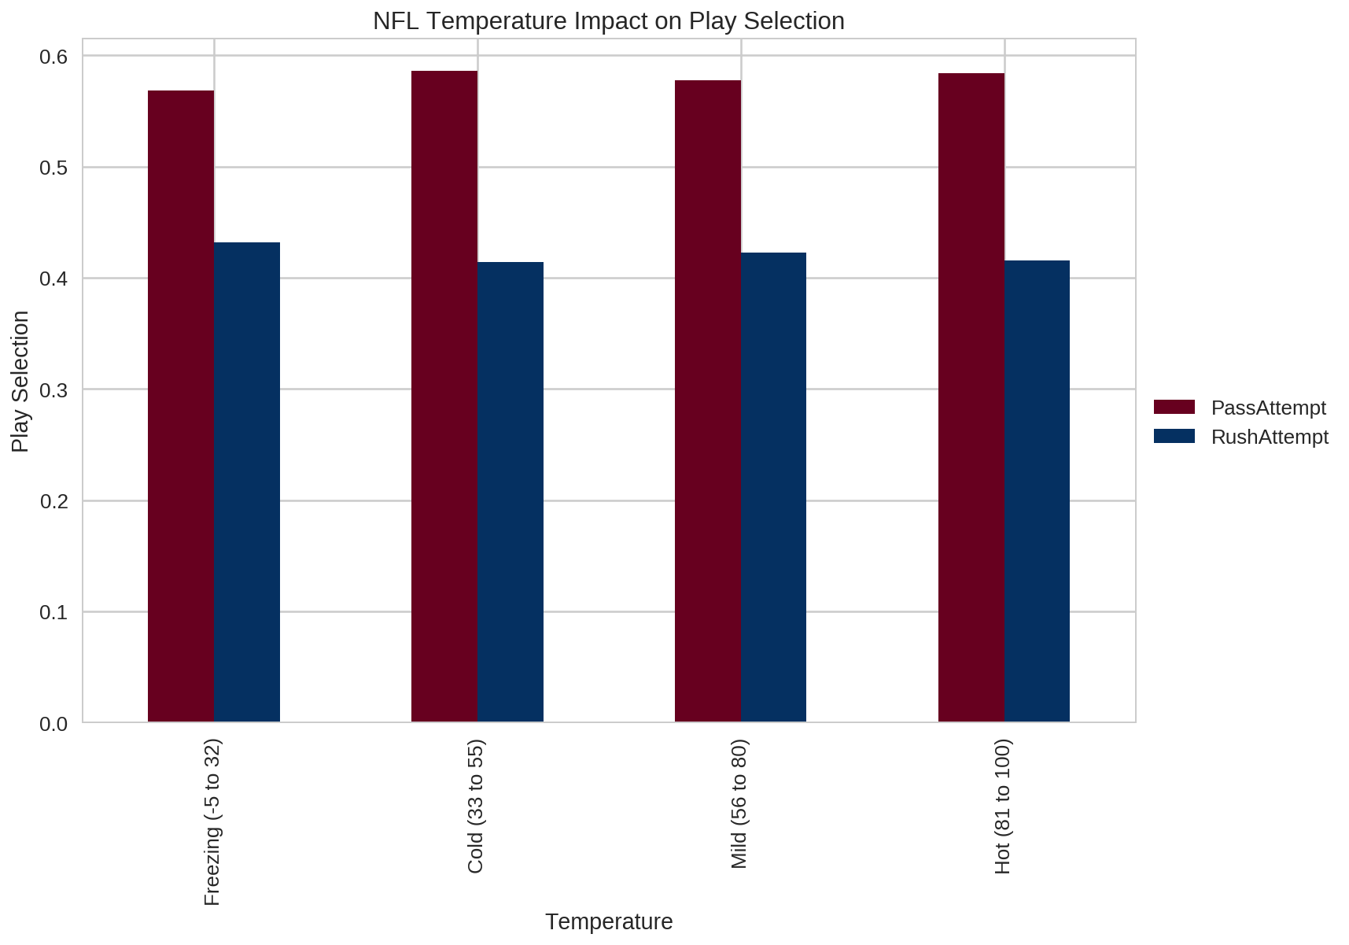
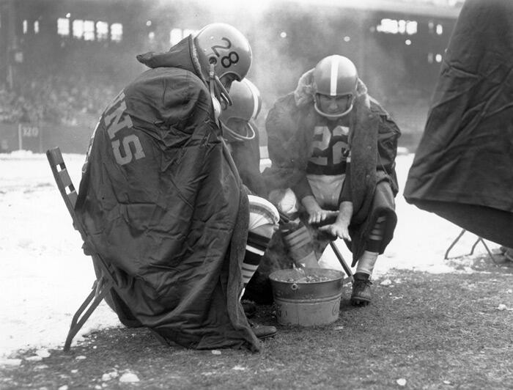
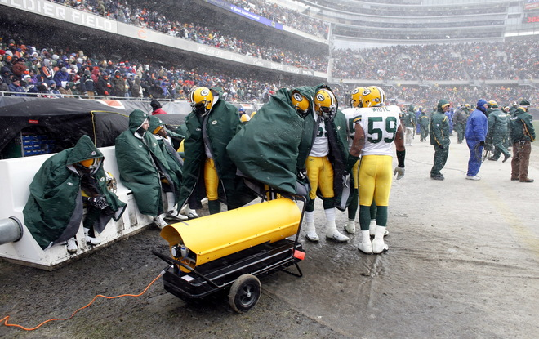
“But, Coach. It’s -5 Degrees!” PASS IT

Slide 14
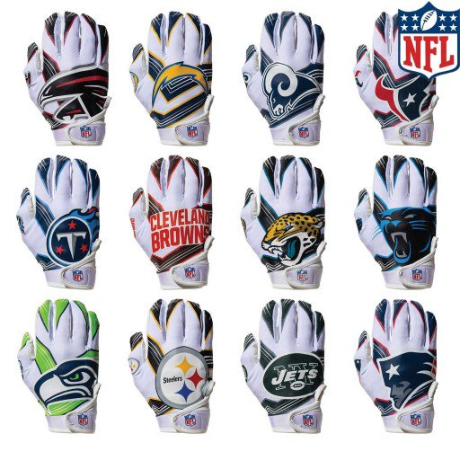
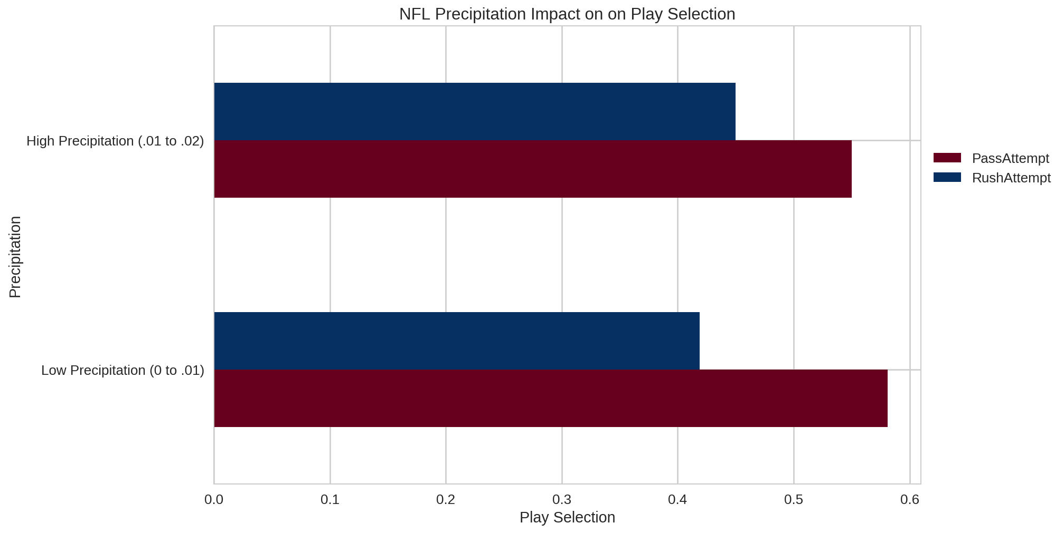
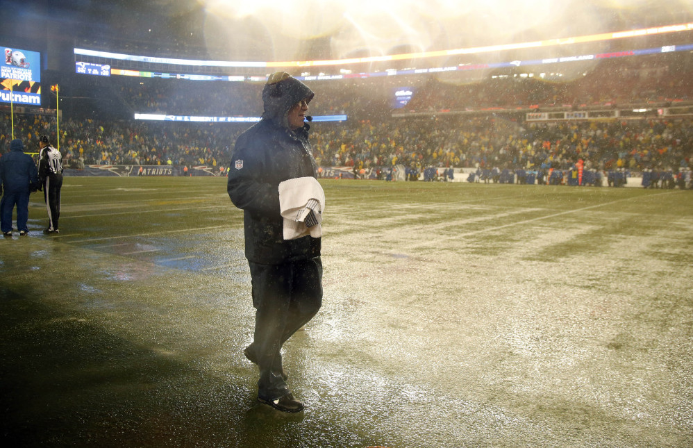
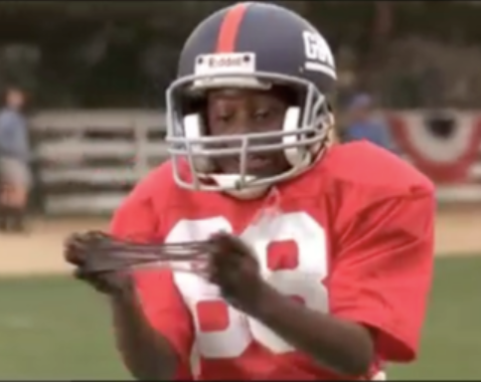
Does the Amount of Rain impact Play Selection?

Slide 15
Third Quarter
Does Weather Affect Score?

Slide 16
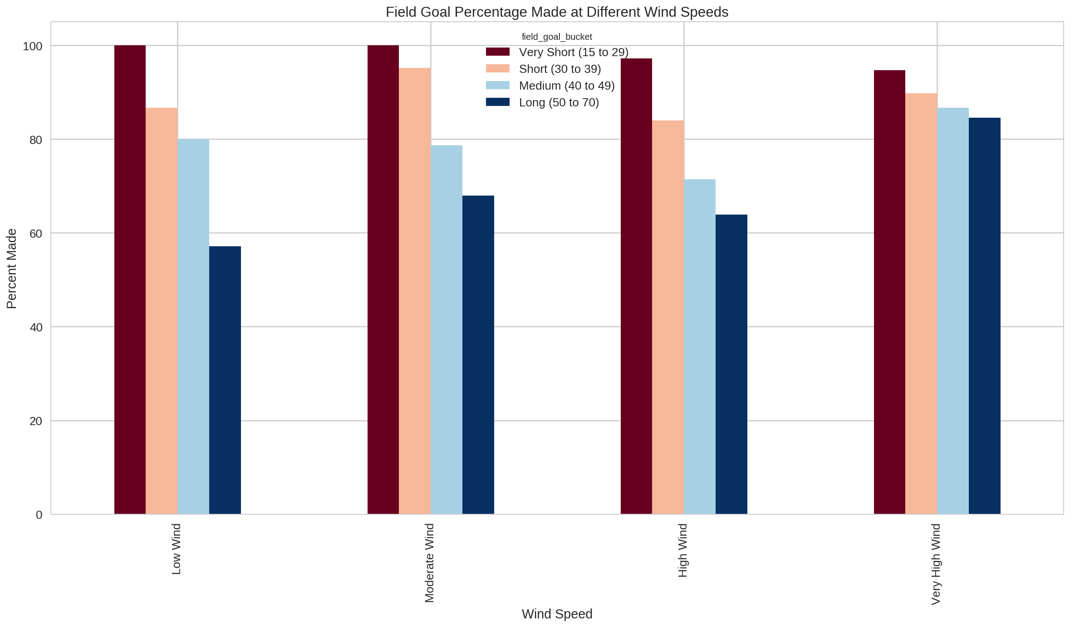
“May the road rise to meet you, may the wind always be at your back...” - Irish Blessing

Slide 17
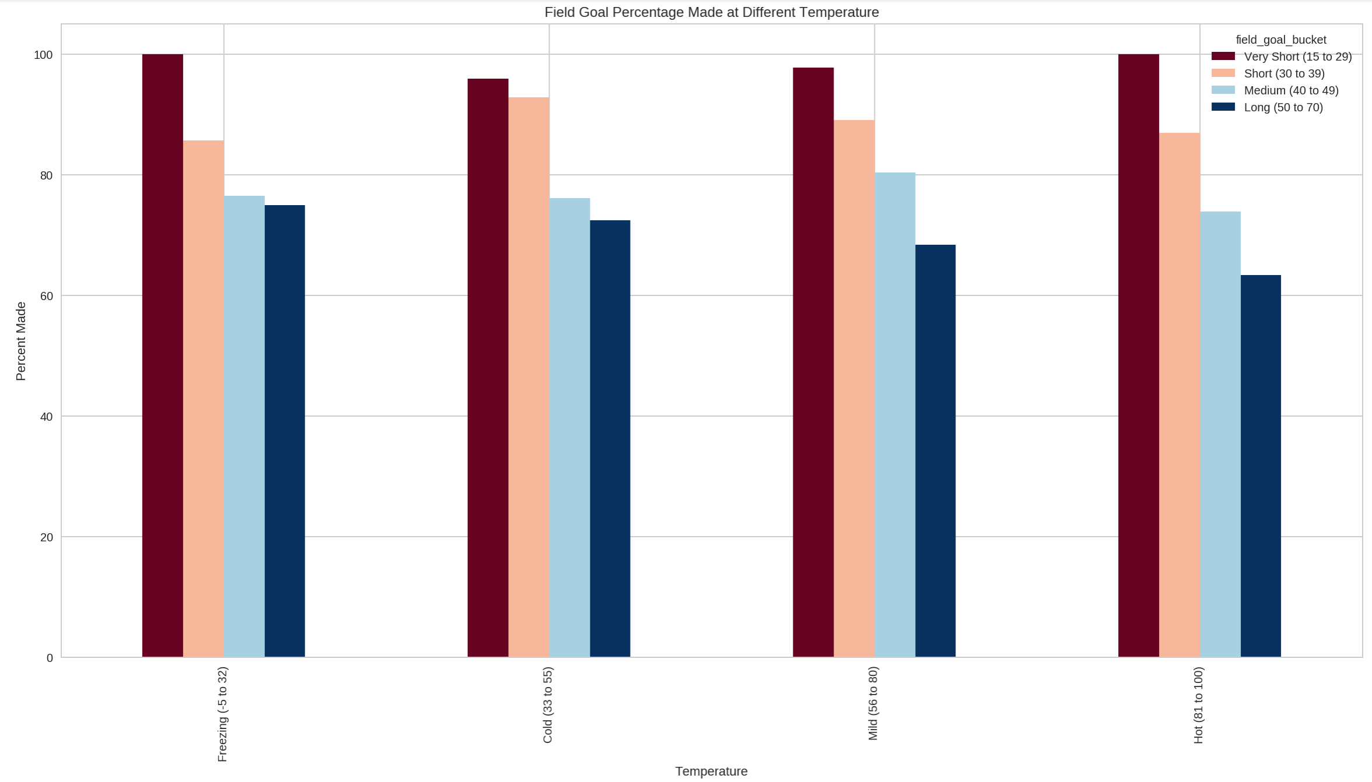
“May the sun shine warm upon your face…” - Irish Blessing

Slide 18
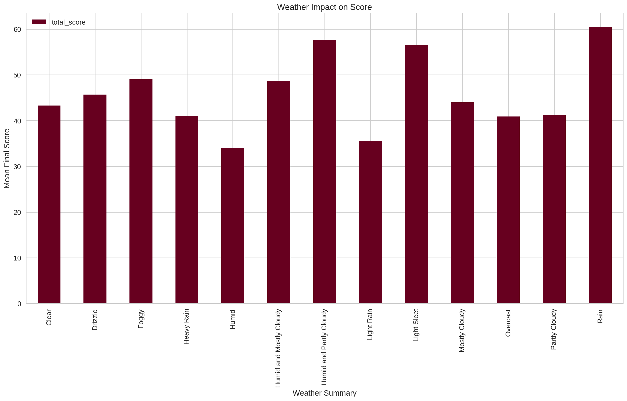
It’s Raining Men...and touchdowns!

Slide 19
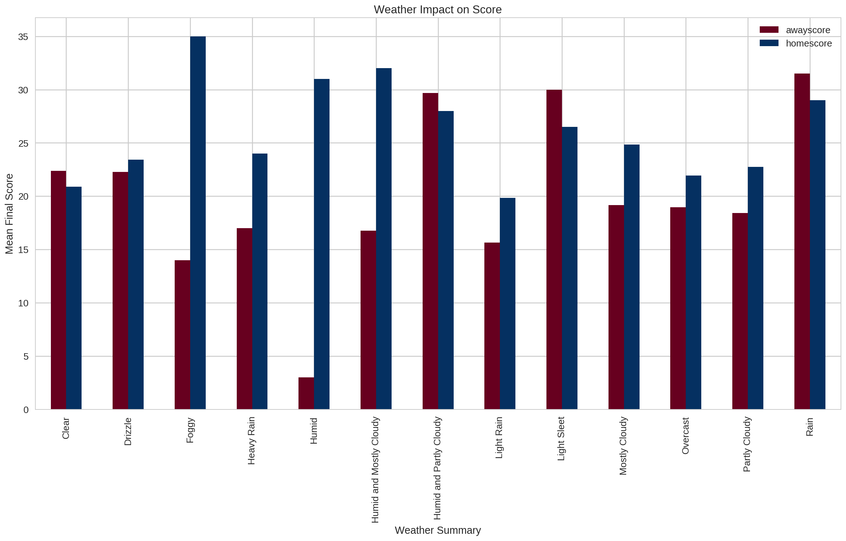
If you’re the visiting team on a Humid day, you may as well just turn the bus around

Slide 20
Fourth Quarter
Was Tom Brady Guilty of Deflating Footballs?

Slide 21
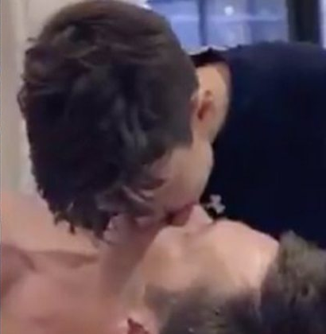
Tom Brady Kisses His Son on the Lips!

Slide 22

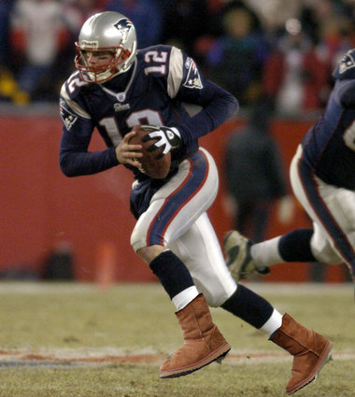
Tom Brady Wears UGG Boots!

Slide 23

Tom Brady Cries Like a Baby!

Slide 24
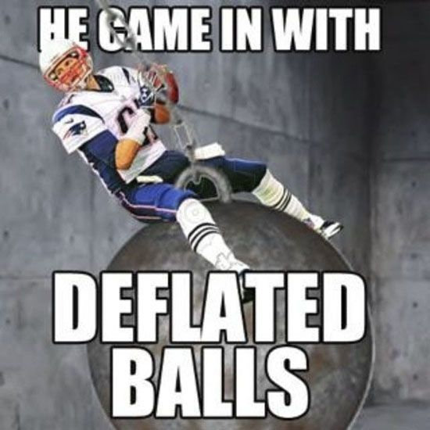
But...is Tom Brady a Cheater?

Slide 25
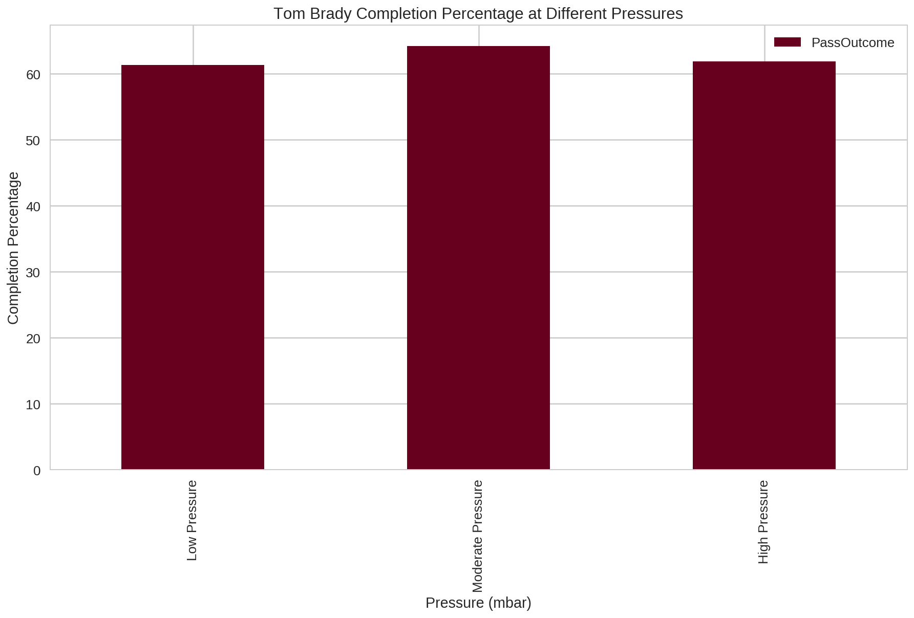
There’s No Statistical Advantage to Deflate Footballs (when you’re Tom Brady)

Slide 26
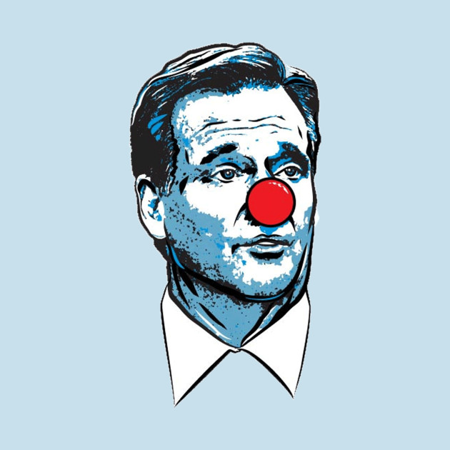
Take THAT, Goodell

Slide 27
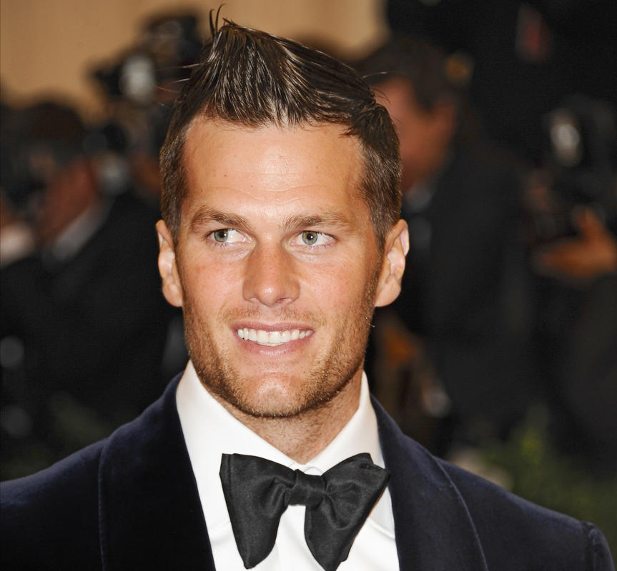

THE GOAT

Slide 28
Overtime
Linear Regression Analysis of Weather Attributes’ Effect on Total Score

Slide 29
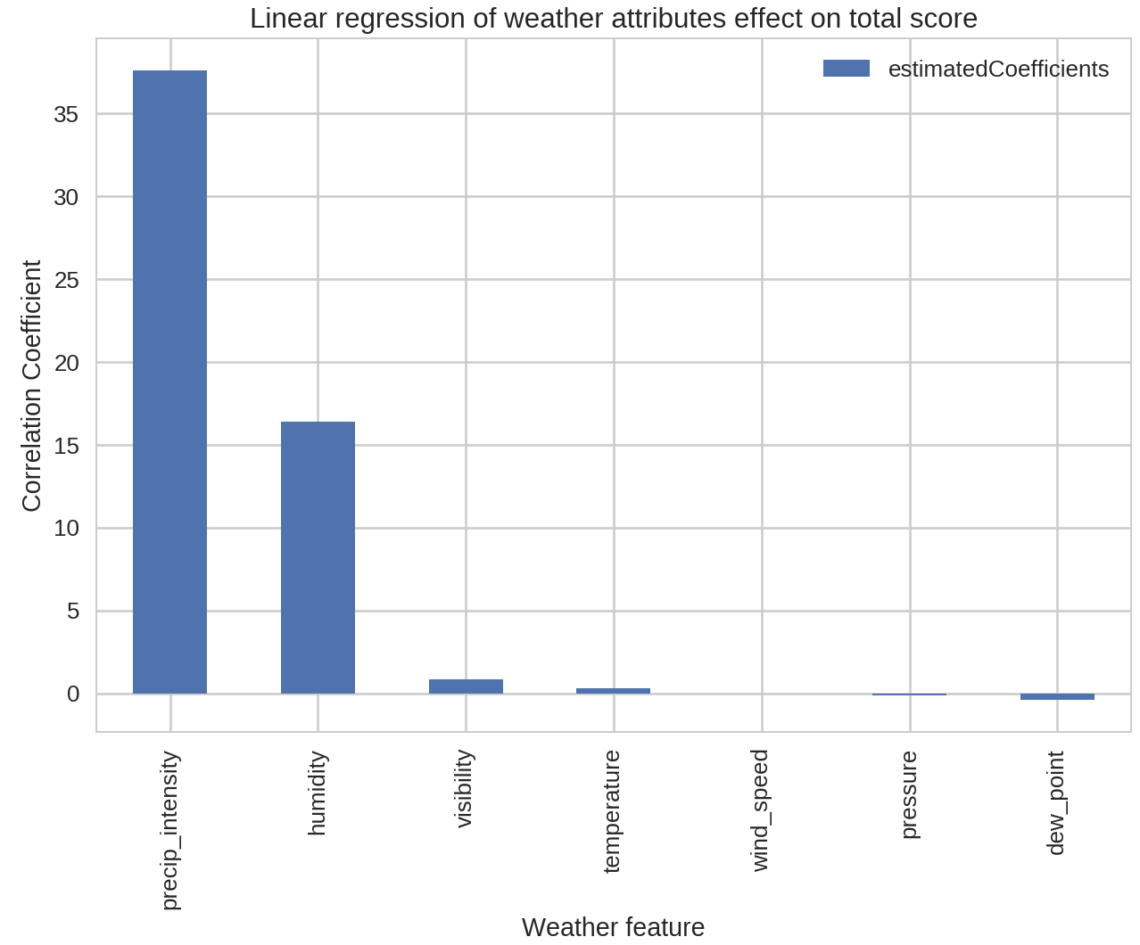
Root Mean Squared Error: 14.42

Slide 30
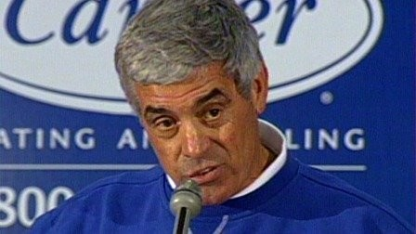
Questions?

